Slide 1

Academic Session 2026-27
ODD Semester July-Dec 2026
UNIVERSITY INSTITUTE OF ENGINEERING AND TECHNOLOGY
Department of TT
Bachelor of Engineering (B.E.) – CSE
Advanced Data Structures / Semester 3
(CS220)
Unit No. 1 Chapter No. 1.1 Lecture No. 9
Topic : Bubble Sort and Complexity Analysis
Abhishek Thakur (E19789) Technical Trainer
Sourav Jaiswal (E19756)-MSC Technical Trainer

Slide 2
Learning Objectives
Understand the Bubble Sort algorithm and its step-by-step working.
Trace Bubble Sort on a given array and count comparisons and swaps.
Analyse best, average, and worst-case time complexity of Bubble Sort.
Implement the optimised Bubble Sort using an early-exit flag.

Slide 3
Bubble Sort — Algorithm
Idea: Repeatedly compare adjacent elements and swap if they are in the wrong order. Largest element "bubbles" to the end each pass.
Algorithm: For i = 0 to n-2: For j = 0 to n-2-i: If A[j] > A[j+1]: Swap A[j] and A[j+1]
Passes needed: At most n-1 passes for n elements. Each pass places the next largest in its correct position.
Optimisation: Add a boolean flag "swapped". If no swap occurs in a pass, array is sorted — exit early.
Best case (optimised): O(n) — already sorted input.

Slide 4
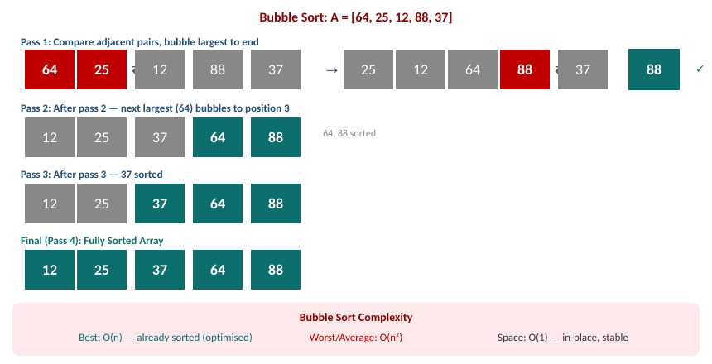
Bubble Sort — Step-by-Step
Visual Trace

Slide 5
Bubble Sort — Complexity Analysis
Best case: O(n) — with optimised flag, already sorted array needs only 1 pass and n-1 comparisons.
Worst case: O(n sq.) — reverse-sorted input requires n(n-1)/2 comparisons and swaps.
Average case: O(n sq.) — on random input, approximately n(n-1)/4 swaps on average.
Space complexity: O(1) — in-place algorithm, only a temp variable needed for swapping.
Stability: Stable — equal adjacent elements are never swapped; their relative order is preserved.

Slide 6
Summary of the Lecture
Bubble Sort compares adjacent elements and swaps them if out of order, pass by pass.
After k passes, the k largest elements are in their correct sorted positions.
Optimised Bubble Sort with swapped flag achieves O(n) best case on sorted input.
Worst and average case: O(n sq.) — inefficient for large arrays.
Space: O(1). Stability: Stable. Use only for small or nearly-sorted datasets.

Slide 7

Next Lecture
Quick Sort — divide-and-conquer approach, partitioning, and O(n log n) complexity.

Slide 8
Quiz/ FAQ's
Q1. Trace Bubble Sort on A = [5, 1, 4, 2, 8]. Show all passes and count total swaps.
Q2. How does the optimised Bubble Sort achieve O(n) best case? Explain with pseudocode.
Q3. In Bubble Sort, after the k-th pass, what can you say about the last k elements?

Slide 9
References/ Articles
Cormen et al., Introduction to Algorithms (CLRS), 3rd Ed., MIT Press.
GeeksforGeeks — Bubble Sort: https://www.geeksforgeeks.org/bubble-sort/
Visualgo — Sorting Visualisation: https://visualgo.net/en/sorting

Slide 10
Thank You
For queries
Email: abhishek.e19789@cumail.in

